Slide 1

Net Room Nights Performance Analysis
Prepared by Gerardo De la O
*information provided isn't to be shared or acted upon and is for evaluation purposes only.

Slide 2
Overview
Goals:
Understand historical performance with respect to Room Night bookings (RN)
Identify key segment drivers of RN
Explore opportunities to improve RN performance
Supporting Analyses
Analysis | Data Goal | Business Purpose
Overall Trend | Exploratory Analysis | How has the business performed lately? Are there any salient patterns?
Segment Drill-down | Hypothesis Generating | Make observations and refine business questions
Statistical Models | Validate and Quantify | Are the observations valid? What is the actual effect of different parameters?
Strategic Recommendations | Make the insights actionable | Understand opportunities and decision points

Slide 3




Summary
3 years of data, spanning 2017 – 2019
Users book more nights during Jan-Feb, while Jun-Aug are the worst performing months
Focus on finding the root cause, and deploy appropriate marketing strategies
4 geographical locations
Region 1 has the highest conversion rate performance and most of the booking volume
Region 1, however, is the worst performer in terms of nights booked. Focus on lifting RN/order
2 platforms (desktop & mobile)
Desktop performance is far superior to that of mobile and increased by over 50% in late 2019
Given that traffic is equal, focus should be on optimizing the mobile experience
10 marketing channels
Channel 1 saw a huge boost in 2019, but channel 2 holds most of the market share
Focus on implementing best practices across channels, and market accordingly

Slide 4
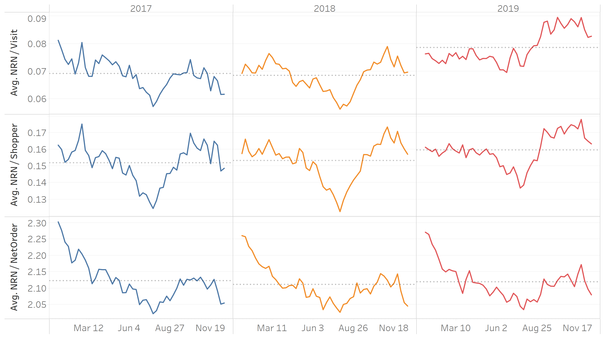
The Data

Slide 5
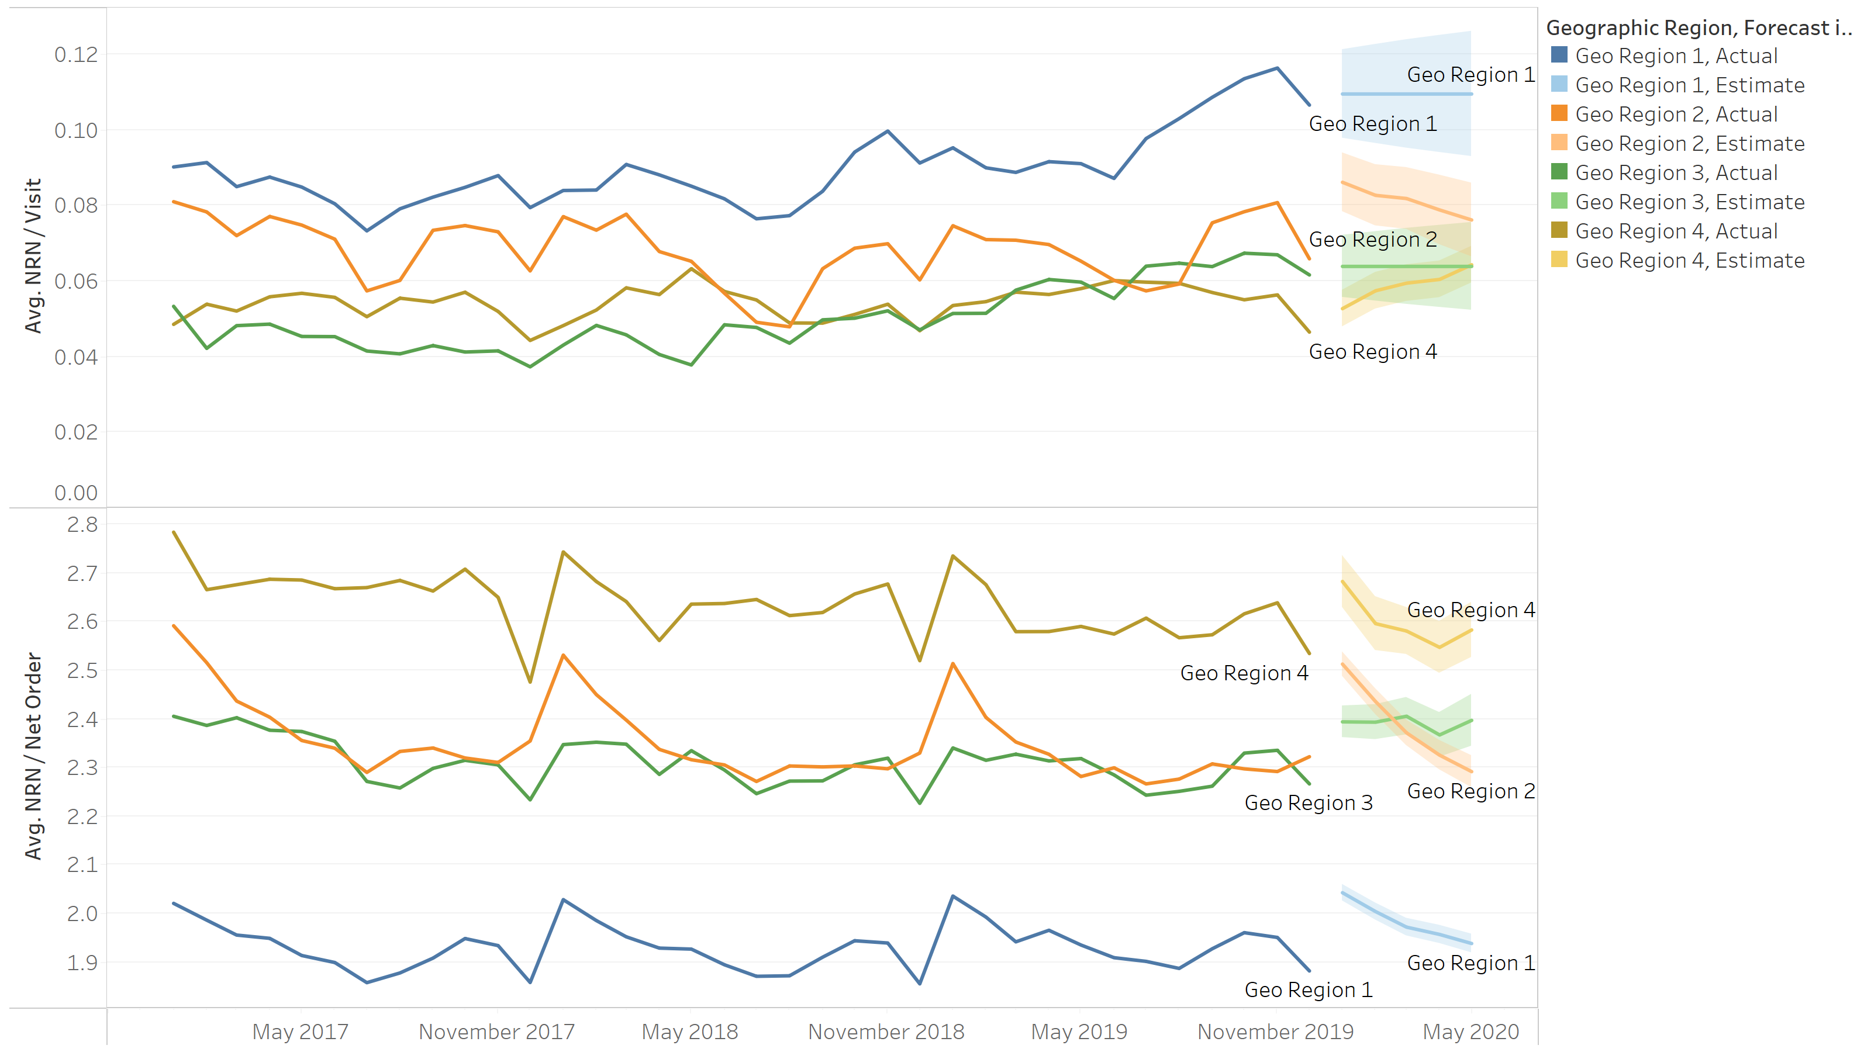
Geography
Key Findings
Region 1 is the top region in terms of booking rate, with .11 RN per visit
However, Region 1 is also the lowest performer in terms of RN per order, with 1.9
Region 4 is the worst region in terms of booking rate, with .06 RN per visit.
However, Region 4 is also the highest performer in terms of RN per order, with 2.4

Slide 6
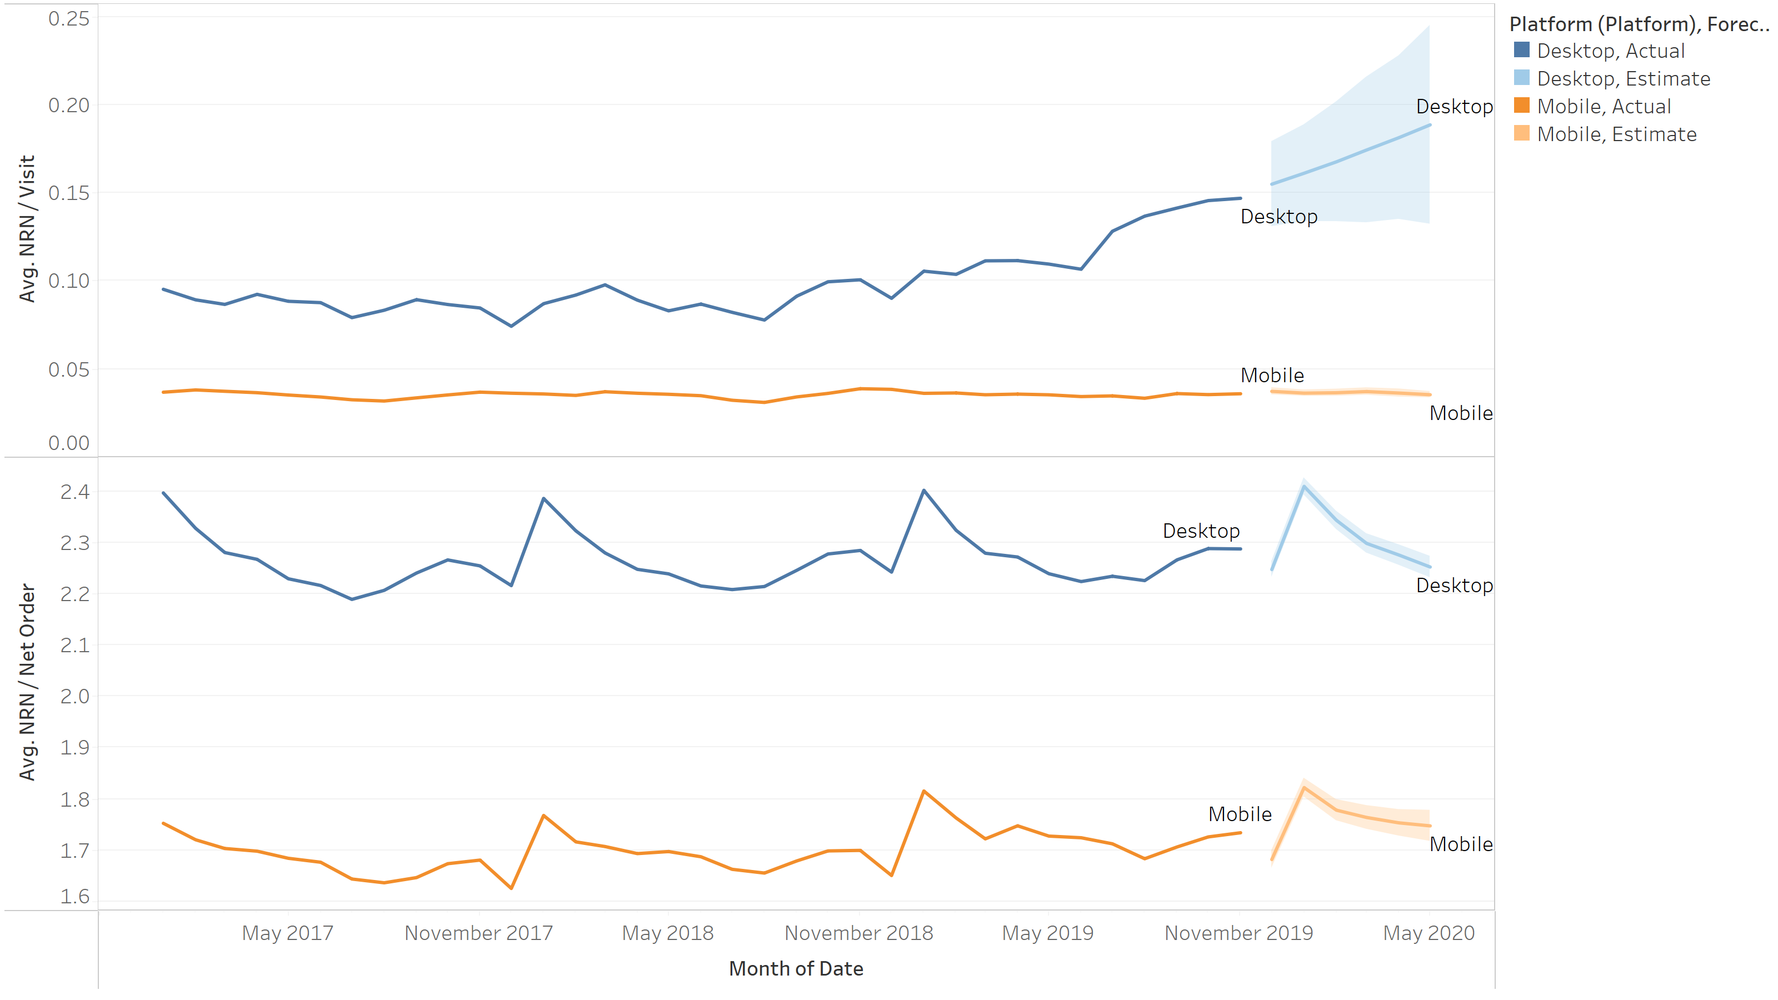
Platform
Key Findings
Desktop outperforms mobile in terms of RN per visit by more than 2X
Desktop: 0.11
Mobile: 0.04
Desktop outperforms mobile in terms of RN per order by 28%
Desktop: 2.44
Mobile: 1.91
Desktop RN per visit increased dramatically in 2019, and the trend remains bullish

Slide 7
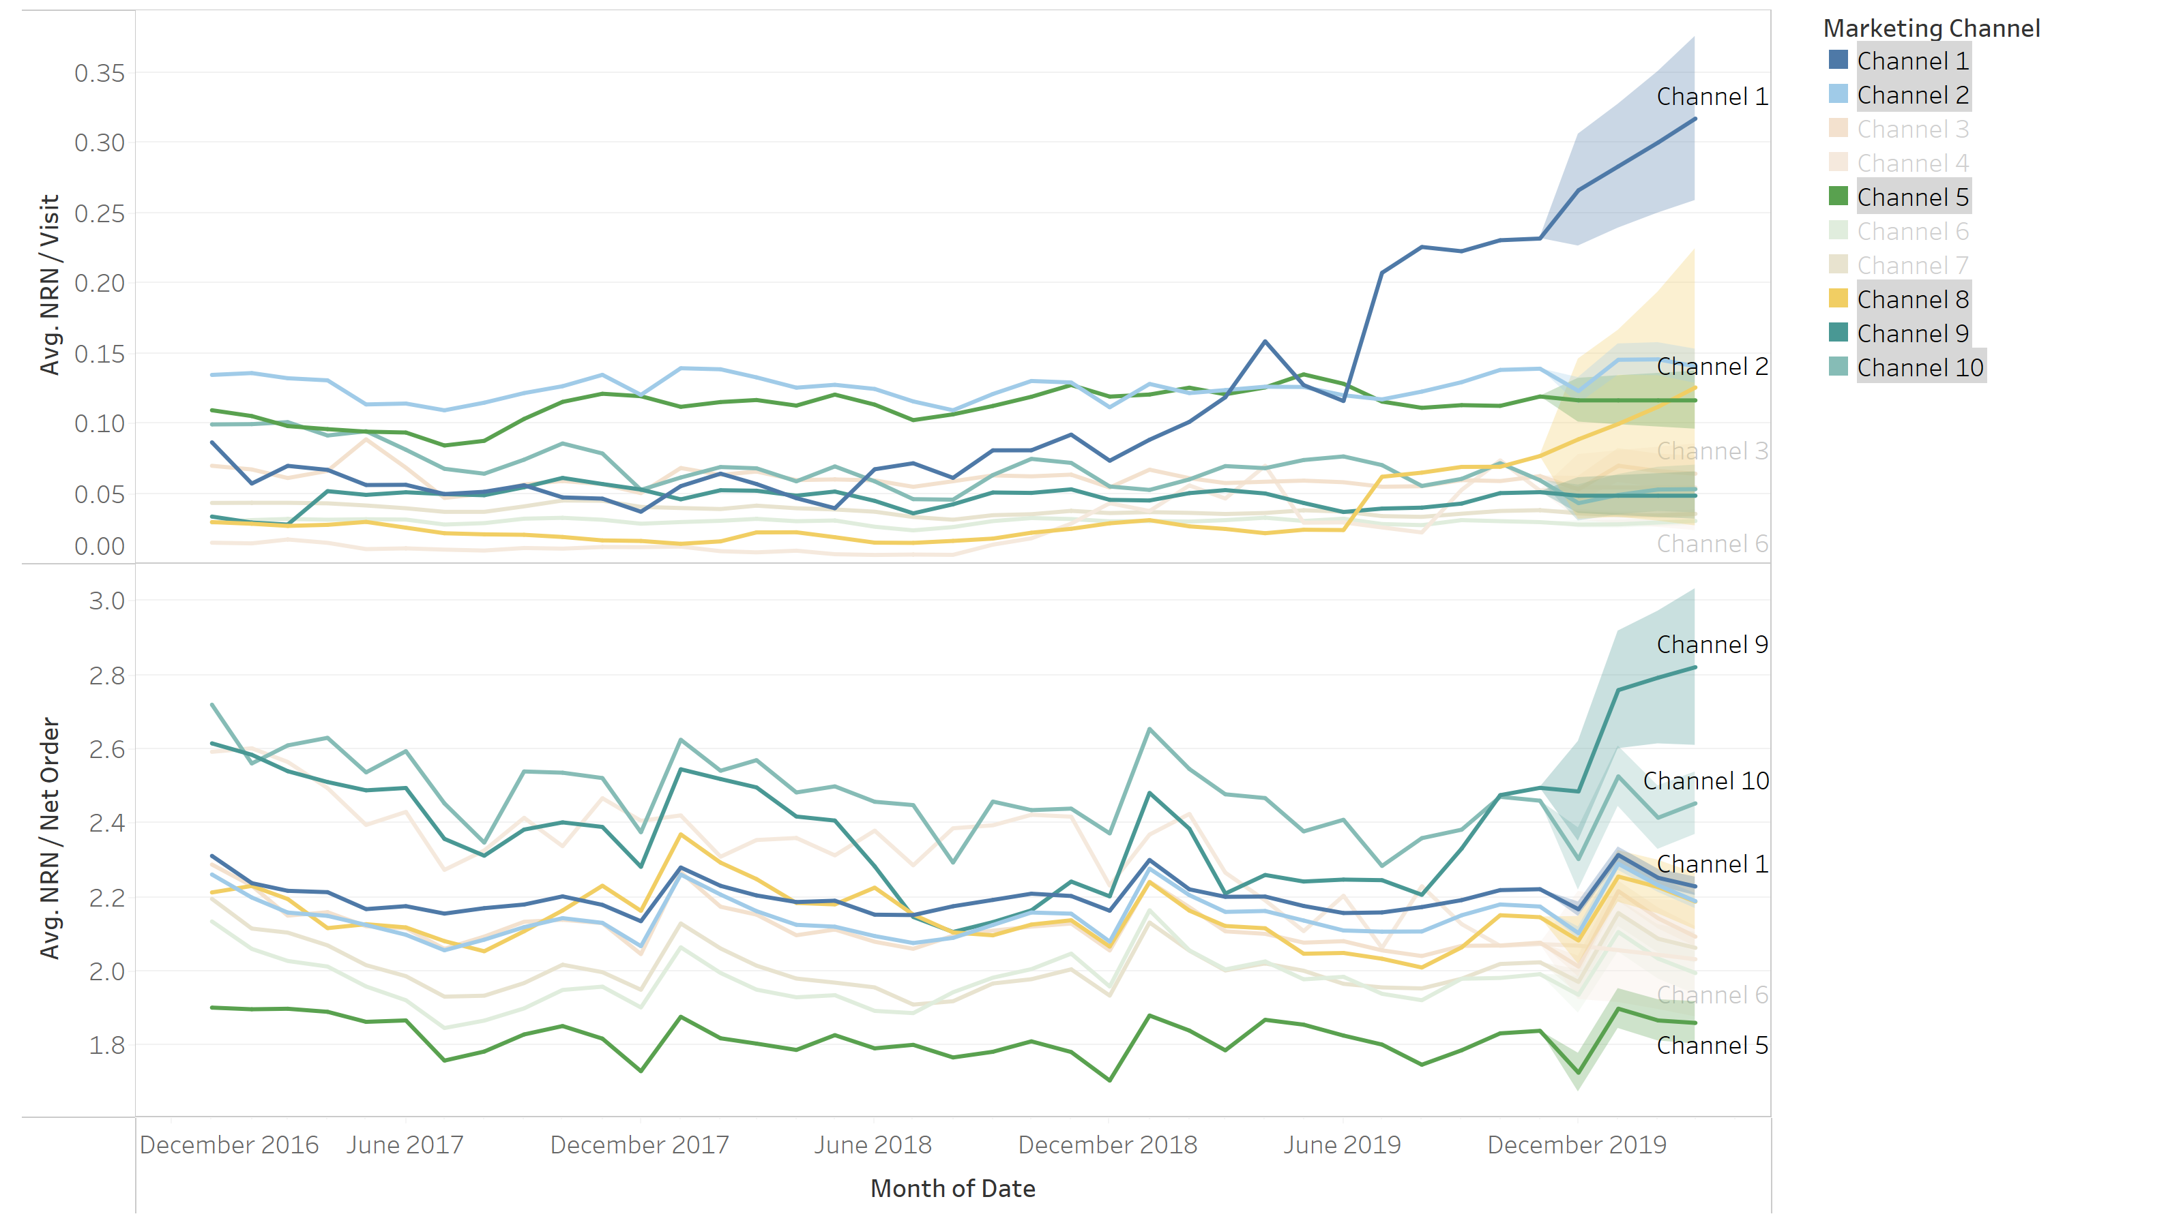
Marketing Channel
Key Findings
In terms of RN per visit, Channels 2 and 5 had been top performers historically, but were surpassed by Channel 1 in 2019
Channel 8 also trended up in 2019
Channels 9 and 10 book the most RN per order, both over 2.25
Channel 5 has consistently underperformed in terms of RN per order, with 1.9

Slide 8
Volume: The remaining piece
Segment Volumes
Key Findings
Regions 1 and 2 dominate volume, so changes here will be the most profitable.
If possible, focus on volume increase for regions 3 and 4
Platform visits are 50/50, but desktop is superior in RN
Mobile performance would be a good research opportunity
Channel 2 dominates both Visit and RN volume. Any change here will be the most profitable
Channels 4, 8, 9 and 10 all have less than 5% share of RNs. Could be candidates for potential sunsetting.
Geo Region | Visits | RNs | % Volume, Visits | % Volume, RN
Region 1 | 335,298,243 | 32,851,712 | 41.0% | 51.5%
Region 2 | 257,591,910 | 17,710,863 | 31.5% | 27.8%
Region 3 | 163,946,168 | 9,859,134 | 20.1% | 15.5%
Region 4 | 60,133,147 | 3,360,875 | 7.4% | 5.3%
Platform | Visits | RNs | % Volume, Visits | % Volume, RN
Desktop | 406,923,825 | 49,252,125 | 49.8% | 77.2%
Mobile | 410,045,643 | 14,530,459 | 50.2% | 22.8%
Mkt Channel | Visits | RNs | % Volume, Visits | % Volume, RN
Channel 2 | 275,650,388 | 34,995,774 | 33.7% | 54.9%
Channel 1 | 43,232,456 | 6,317,841 | 5.3% | 9.9%
Channel 3 | 98,465,181 | 5,738,605 | 12.1% | 9.0%
Channel 7 | 114,679,033 | 4,141,897 | 14.0% | 6.5%
Channel 6 | 129,682,639 | 3,894,527 | 15.9% | 6.1%
Channel 5 | 30,209,092 | 3,626,140 | 3.7% | 5.7%
Channel 8 | 61,566,143 | 2,192,685 | 7.5% | 3.4%
Channel 9 | 47,680,009 | 2,154,785 | 5.8% | 3.4%
Channel 4 | 12,713,867 | 530,974 | 1.6% | 0.8%
Channel 10 | 3,089,232 | 189,364 | 0.4% | 0.3%

Slide 9
Conclusions & Proposals
Geographic Region
Region 1 is a high volume, high booking rate region, but is lacking in RN per order.
Focus on promoting additional nights per booking
Incentivize additional nights booked on each order for this region
Platform
Mobile is underperforming compared to Desktop despite having similar visits. Also, Mobile tends to be much more accessible, which gives the platform a potentially larger market share.
Focus on increasing mobile booking rates and RNs per order:
Perform market research to find out why Mobile is not as successful as Desktop
Improve the user experience for mobile devices, making it easy to place an order
Marketing Channel
Channel 1 saw explosive growth in 2019, outperforming the booking rate of every other channel
Channel 2 has the largest volume by far, but only average on RN per order
Focus on investigating and replicating methodology implemented in Channel 1 for other channels AND on promoting additional nights on Channel 2

Slide 10
What Else?
Trend and segmentation analyses are extremely useful tools for business understanding. In this presentation, we’ve identified potential areas of improvement, but we still don’t know what the best solution for each problem is. In order to optimize solutions, we need to understand our customers!
Additional data could help us dig into the “WHY”!
User behavior
User engagement
Literature on travel trends
Marketing initiatives
New product releases
Booking site metadata
Segment characteristics
Geographical demographics
Market Channel metadata
Mobile sub-categories
Industry trends
Competitive environment

Slide 11

QUESTIONS?

